Slide 1


Slide 2


The Market
Notes:
Benefits
1600 Coffee shops
Currently spending €500 pm
1.6 million smartphone users
72% use their smartphone in restaurants

Slide 3
Customer Benefits
Notes:
Benifits

Slide 4
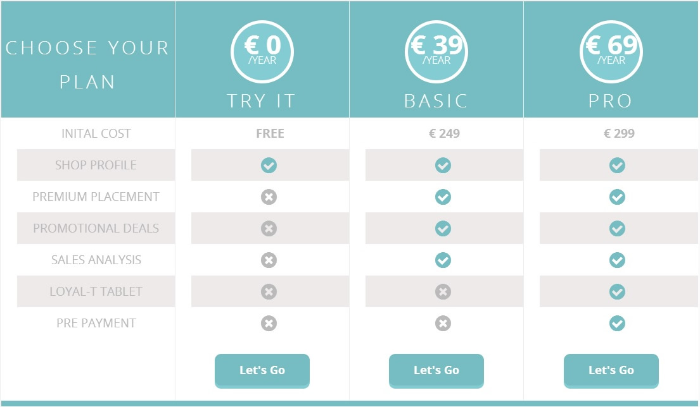
The Plans
Notes:
Benifits

Slide 5


Research & Development
Notes:
Benefits
EPOS Integration
Pre Order & Payment System

Slide 6
The Display
Notes:
The Display
Versatile till integration
Quick and easy set up
Eye catching display
Brand enforcement

Slide 7
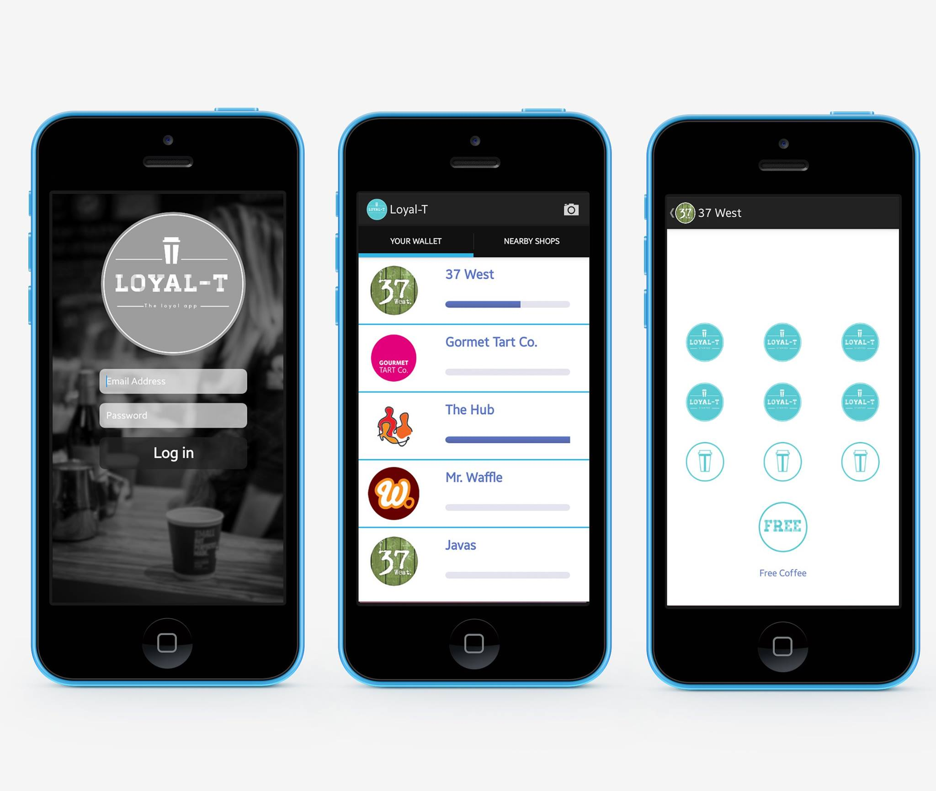
Application
Notes:
Benifits

Slide 8
Notes:
Into

